Slide 1
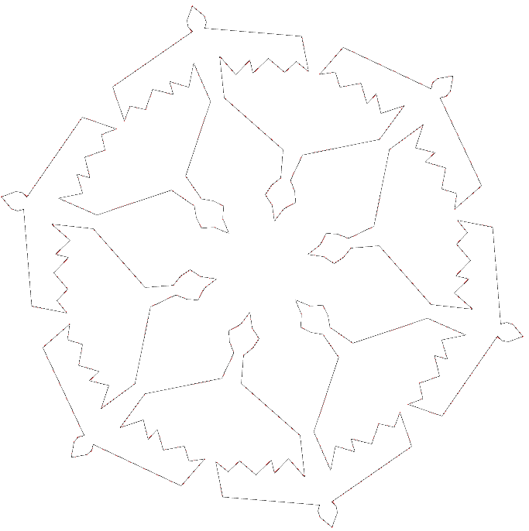
SnowFlock: Rapid VM Cloning for Cloud Computing
http://sysweb.cs.toronto.edu/snowflock
H. Andrés Lagar-Cavilla
Joe Whitney, Adin Scannell, Steve Rumble, Philip Patchin, Eyal de Lara, Michael Brudno, and M. Satyanarayanan*
University of Toronto, *CMU

Slide 2
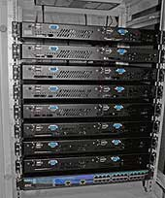
Cloud
Utility Computing
Many machines
Many users
Many applications
Virtualization is key

Slide 3
Virtualization
Decoupling
Consolidation
Security Isolation
Configuration Isolation
BIG!
OS kernel
Processes
IPC, sockets, pipes
File system
HW
More HW

Slide 4
Dynamic Application Scaling
Requests
Requests
Requests
DNA search, render,
quant finance
Server
Parallel
Computation

Slide 5
Poor Cloud Application Scaling
1. The programming model is awkward
“Boot and push”
Today: Application state transmitted explicitly

Slide 6
Poor Cloud Application Scaling
2. The response time is slow
Big VM state swap-in
Today: Predict load, pre-allocate, keep idle, consolidate, migrate

Slide 7
Problem: Poor Cloud App Scaling
Not Stateful
New VMs need to have state pushed
Not Swift
New VMs come up in minutes
Slow swap-in: full VM transmission
Boot from scratch
Live migrate
Suspend/resume
Notes:
More background on cloud
Define EC2 -> introducing new terms explicitly

Slide 8
Q: What’s stateful and swift?
A: Fork

Slide 9
SnowFlock: VM Fork
Stateful swift cloning of VMs
State inherited up to the point of cloning
Local modifications are not shared
Clones make up an impromptu cluster
Virtual Network
VM 0
VM 1
VM 2
VM 3
VM 4
Host 0
Host 1
Host 2
Host 3
Host 4
Notes:
Fork: read-only mem, they die

Slide 10
Fork: Well Understood Semantics
partition data
fork N workers
if child:
work on i^{th} slice of data
if more load:
fork extra workers
if load is low:
dealloc excess workers
Parallel Computation
Load-balancing Server
trusted code
fork
if child:
untrusted code
if cycles available:
fork worker
if child:
do fraction of long computation
Sandboxing
Opportunistic Computation

Slide 11
VM Fork Challenge
Suspend/resume latency
Big VM State Tx
VMs are big:
OS, disk, processes, …
Big means slow
Big means not scalable
At odds with fundamental bottleneck
Shared IO Resources
Seconds
VMs
Notes:
What does stateful refer to => why do I move all that stuff => why SF is good

Slide 12
SnowFlock Insights
VMs are BIG: Don’t send all the state!
Clones need little state of the parent
Clones exhibit common locality patterns
Clones generate lots of private state
Notes:
Insights: locality, little actual state

Slide 13
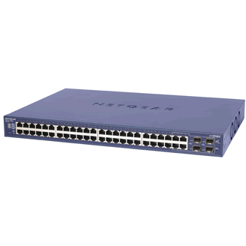
The Secret Sauce
3. Multicast: exploit net hw parallelism
4. Multicast: exploit locality to prefetch
5. Heuristics: don’t fetch if I’ll overwrite
1. Start only with the basics
2. Fetch state on-demand
State:
Disk, OS, Processes
Clone 1
Private
State
Virtual
Machine
?
Multicast
VM Descriptor
VM Descriptor
VM Descriptor
Clone 2 Private State
Metadata
“Special” Pages
Page tables
GDT, vcpu
~1MB for 1GB VM
?
Notes:
What does stateful refer to => why do I move all that stuff => why SF is good
VMs are empty is bad

Slide 14
Why SnowFlock is Fast
Start only with the basics
Send only what you really need
Multicast
Network hardware parallelism
Prefetch: exploit locality patterns
Heuristics
Don’t send if I’ll overwrite
Malloc: exploit apps generating new state

Slide 15
Clone Time
Milliseconds
Clones
Scalable Cloning: Roughly Constant
Notes:
Multicast + start clones

Slide 16
SnowFlock
32 VMs
800 Milliseconds

Slide 17
Page Fetching, SHRiMP 32 Clones 1GB
Heuristics OFF
Heuristics
ON
10K

Slide 18
SnowFlock
40 MB sent instead of 32GB
(no more BIG VM state)
Notes:
This needs more explaining

Slide 19
Application Evaluation
Embarrassingly parallel
32 hosts x 4 processors
CPU-intensive
Internet server
Respond in seconds
Bioinformatics
Quantitative Finance
Rendering

Slide 20
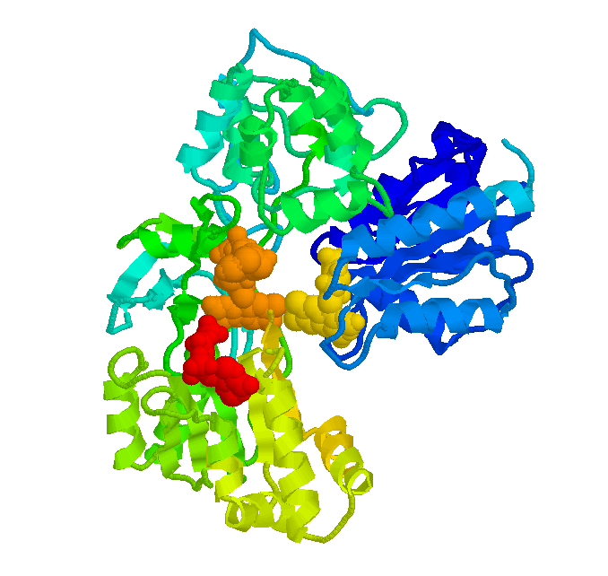
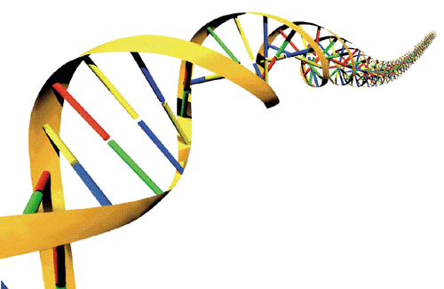
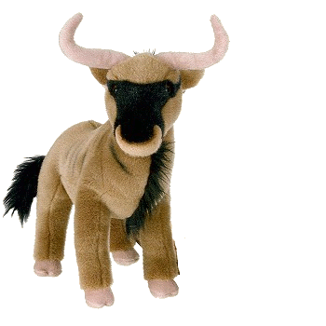
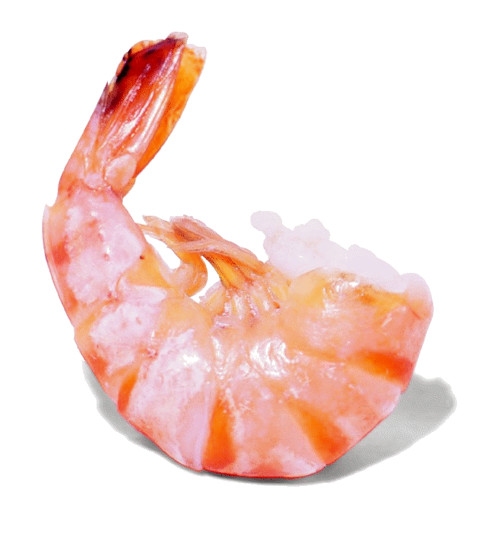
Application Run Times
1-4 second overhead
Notes:
Ideal is really ideal - unlikely
Low is good -

Slide 21
SnowFlock
≤ 7% Runtime Overhead
~ 5 seconds

Slide 22
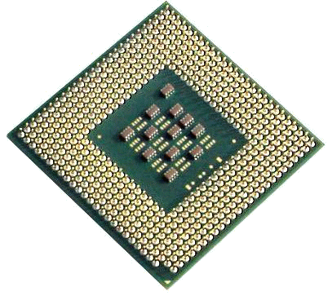
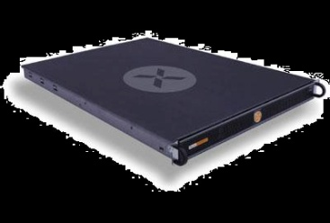
Throwing Everything At It
Four concurrent sets of VMs
BLAST , SHRiMP , QuantLib , Aqsis
Cycling five times
Clone, do task, join
Shorter tasks
Range of 25-40 seconds: interactive service
Evil allocation

Slide 23
Throwing Everything At It
Four concurrent sets of VMs
BLAST , SHRiMP , QuantLib , Aqsis
Cycling five times
Clone, do task, join
Shorter tasks
Range of 25-40 seconds: interactive service
Evil allocation

Slide 24
Throwing Everything At It
Fork. Process 128 x 100% CPU. Disappear.
30 Seconds
Notes:
Move this back in

Slide 25
The Bottomline
Stateful, Swift and Scalable
800ms, 32VMs
≤ 7% runtime overhead
Only 40MBs on IO bottleneck, instead of 32GB
Intuitive, well-understood semantics
But how do use it?

Slide 26
SnowFlock API
tix = sf_request_ticket(howmany)
prepare_computation(tix.granted)
me = sf_clone(tix)
do_work(me)
if (me != 0)
send_results_to_master()
sf_sync()
else
receive_results()
sf_join(tix)
Just like UNIX fork()
Block…
scp … more in the future
Child VMs are gone
Notes:
Drive analogies with fork()

Slide 27
Many Ways to Use SnowFlock
Add VM Fork to your code
Implement MPI with SnowFlock
Patchin, HPC Virt 09
Fun with Python scripting
SnowFlock-based job dispatcher
Clustered web server
Implement MapReduce with SnowFlock
Cloud/cluster manager
Present
Future

Slide 28
SnowFlock: VMs on-demand
Stateful, Swift and Scalable
VMs on-demand, when I need them, cheap
No more over-provisioning!
No load prediction
No pre-allocation
No idle VMs
No memory consolidation
No migration

Slide 29
Conclusion: SnowFlock In One Slide
VM fork: natural intuitive semantics
The cloud bottleneck is the IO
Clones need little parent state
Generate their own state
Exhibit common locality patterns
Sub-second cloning time
Negligible runtime overhead
Scalable: experiments with 128 processors
Notes:
Let people finish their questions

Slide 30
Thanks!
andreslc@cs.toronto.edu
http://www.cs.toronto.edu/~andreslc
http://sysweb.cs.toronto.edu/snowflock
This slide is not endorsed by the conference chair ☺

Slide 31
Extra Slides

Slide 32
Disk
Just like memory
Multicast and heuristics
Virtual disk only for the “boot volume”
SnowFlock is good at cloning common contents
Big data in suitable FS
Future work

Slide 33
Just-in-Time Cloud
Opportunistically clone over the wide area
Use the cloud from your laptop
“Cloud bursting”, a form of cyber foraging
Memory-on-demand, heuristics
Prefetching, content-addressable storage

Slide 34
The Future of SnowFlock
SnowFlock + Big data
Make VMs agnostic to the file system
Allocate VMs based on data availability
The Abstract Data Type
Data + operations/transformations
Big data objects + VM-encapsulated operation?

Slide 35
SnowFlock API
mpirun –np 128
Hide behind parallel API (MPI)
Now you can use the cloud with unmodified apps
And well-known commands
Patchin, HPC Virt 09

Slide 36
Memory on Demand Latency
Network
(unicast)
Memtap logic
(map page)
Context switch
to dom0
Xen hypervisor
(shadow PT)
SnowFlock
in hypervisor
Page Fault (HW)

Slide 37
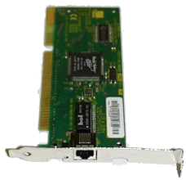
Memtap: Memory-on-demand
Dom0 - memtap
VM
paused
Maps
Page Table
9g056
9g056
R/W
Bitmap
c0ab6
bg756
bg756
Kick back
776a5
0
03ba4
1
1
1
1
00000
00000
9g056
Read-only
Shadow
Page
Table
c0ab6
00000
Kick
00000
Hypervisor
00000
Page Fault
03ba4

